Slide 1

KGiSL INSTITUTE OF TECHNOLOGY
COIMBATORE
DEPARTMENT OF computer science & engineering
Project phase review
Data Leakage and Security on Cloud
TEAM MEMBERS:
711719104019 DANUSU B
711719104030 HARI PRASATH S
711719104035 JEGADEESWARAN R
711719104305 MOHANKUMAR S Under the guidance of :
Mr. RAJINIGANTH R, AP/CSE

Slide 2

agenda
Objective of the project work
Existing System
Proposed System
Conclusion
Future Enhancement
References
Timeline

Slide 3
OBJECTIVE / abstract
The impact of a data breach and data loss is enormous. Data breaches at companies like precisely exposed 340 million customer records. The incident also resulted in financial loss too, reputational damage, loss of customer trust, and compliance issues with the firm. Most of the data was processed via a Third Party Application (TPA) and users are unaware of the security basics. To detect data leaks, this project proposes a method that includes performing a packet capture on the platform. The proposed model also protects the data before downloading via the TPA, and after successful download of the data the secret key is sent to the original user without being intercepted by the TPA.

Slide 4
EXISTING SYSTEM
In some applications, fake objects can cause less problems than real objects. For example, suppose the distributed data object is a medical record and the agent is a hospital.
Adversary model catches all kinds of threats to data integrity, this cloud data is not specified on the cloud client side, but in the cloud, service provides a domain address. This can be caused by two attacks
1)Insider attack: The cloud service provider is not trusted.
2) External Attacks: These attacks originate from third-party and non-domain-controlled cloud service providers.

Slide 5
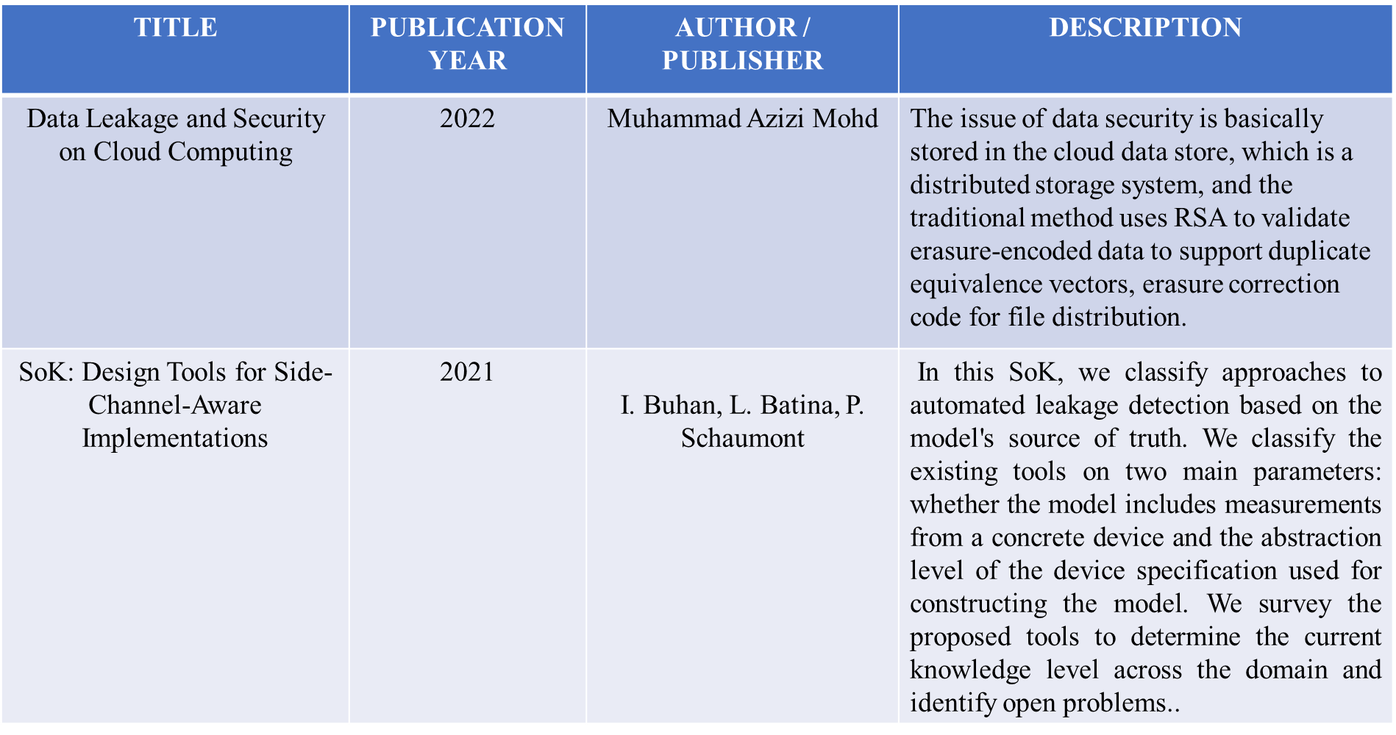
Literature Survey

Slide 6
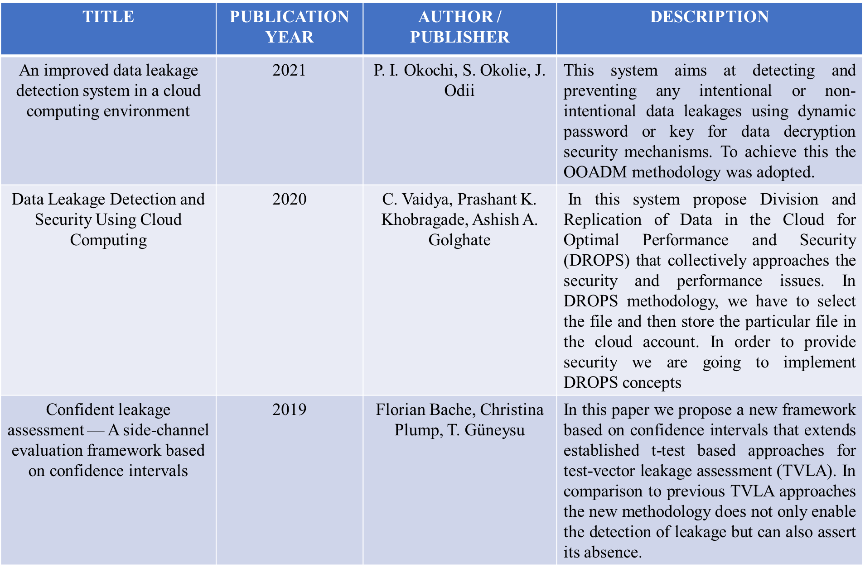
Literature Survey

Slide 7
PROPOSED SYSTEM
The proposed method proposes the addition of a “realistic but false record” that increases the probability of data distribution strategy and leak detection and the encryption algorithm improves data security.
It can also keep your data safe and detect leaks during transmission.
To address data breaches, implementations of various data dissemination strategies have been submitted that may increase the likelihood that a data breach will be detected by a distributor.

Slide 8
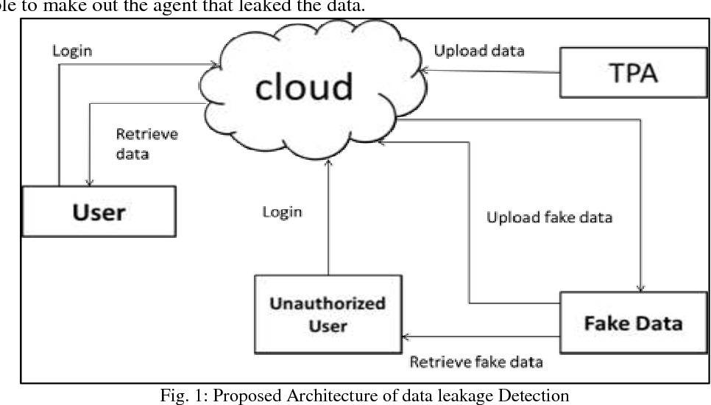
ARCHITECTURAL DIAGRAM

Slide 9
Modules split up
USER REGISTRATION:-
Existing user can login by using their username and password. A new user has to do the registration process to access the application in online. User can view the test menu which is posted by the admin. The registration process includes username, password, address, phone etc.
TPA ACTIVITY:-
With the help of this system user can view the available the details which includes uploading/downloading the data using cloud. These activities are updated to test the user’s convenience.

Slide 10
Modules split up
Secret Key Generation
An unauthorized user, cannot access or download the file or data without the secret key than can be only granted by the sender of the data or file.
Leaked Message Detection
If the user does not provide the valid secret key within twice chances, then the data or files cannot be accessed by the user and the user will be blocked by the admin automatically.

Slide 11
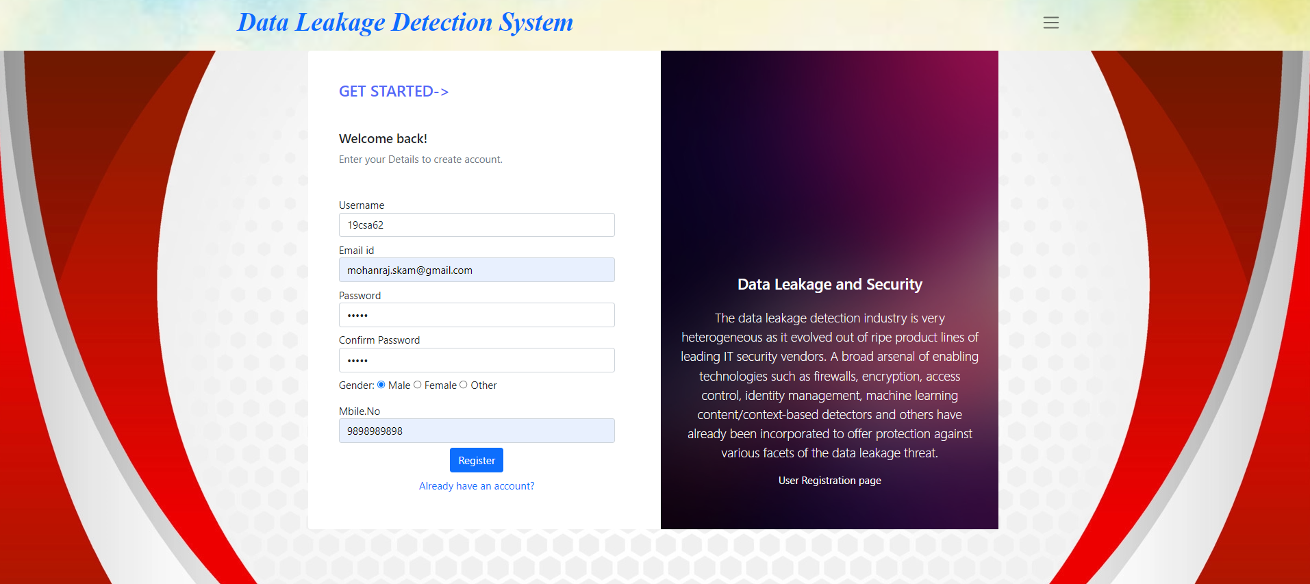
Registration page

Slide 12
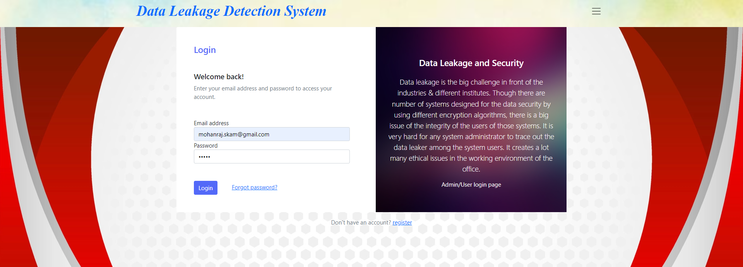
Login page

Slide 13
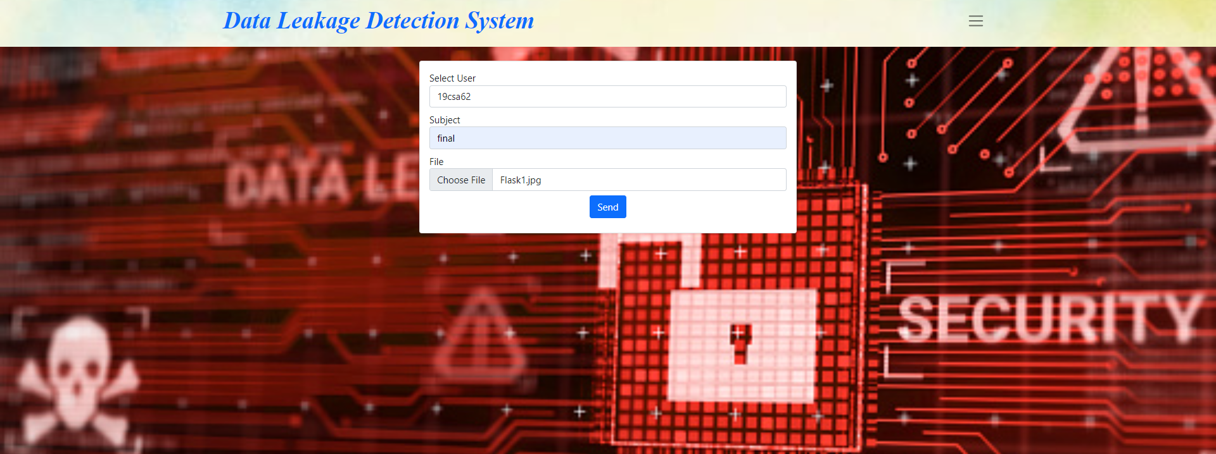
File sharing

Slide 14
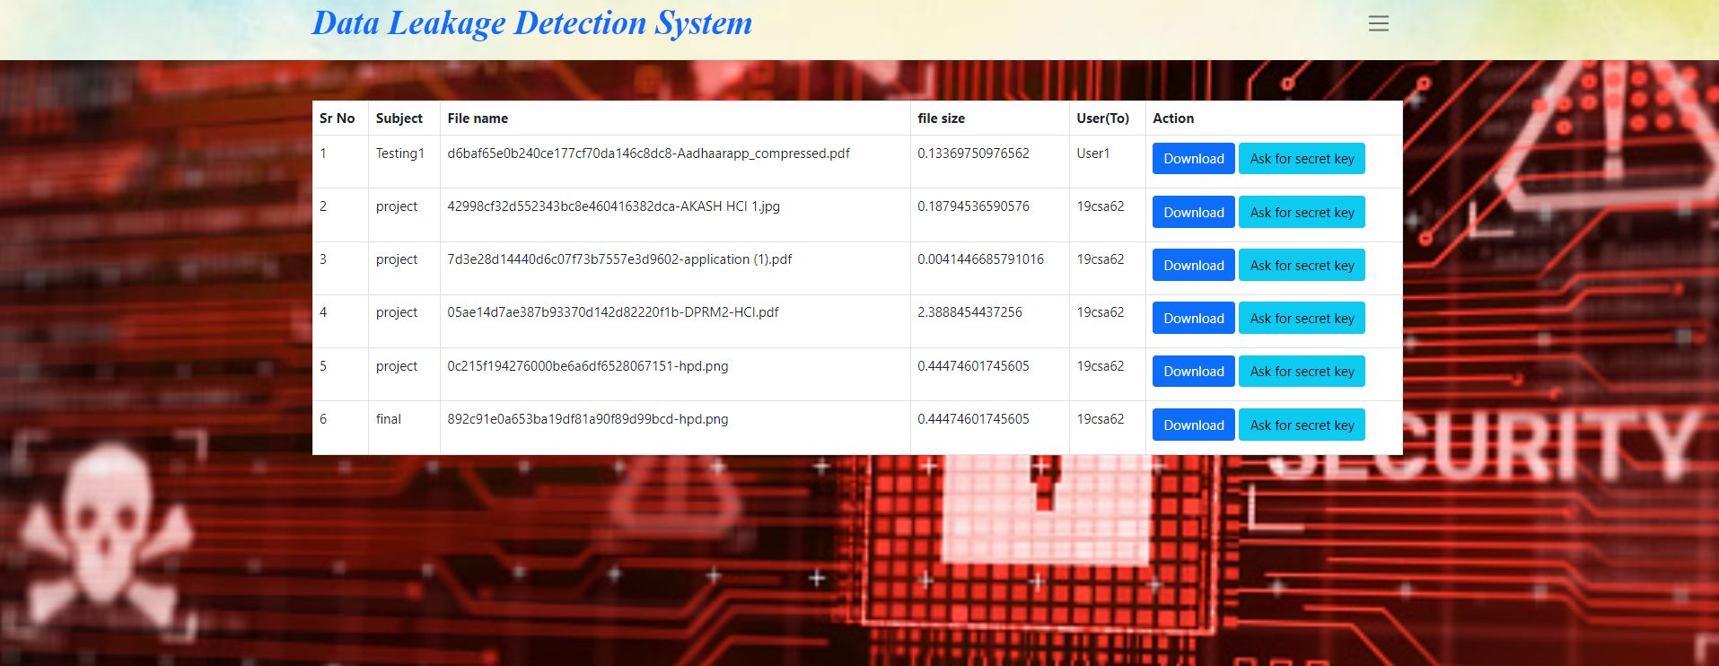
Secret key generation

Slide 15
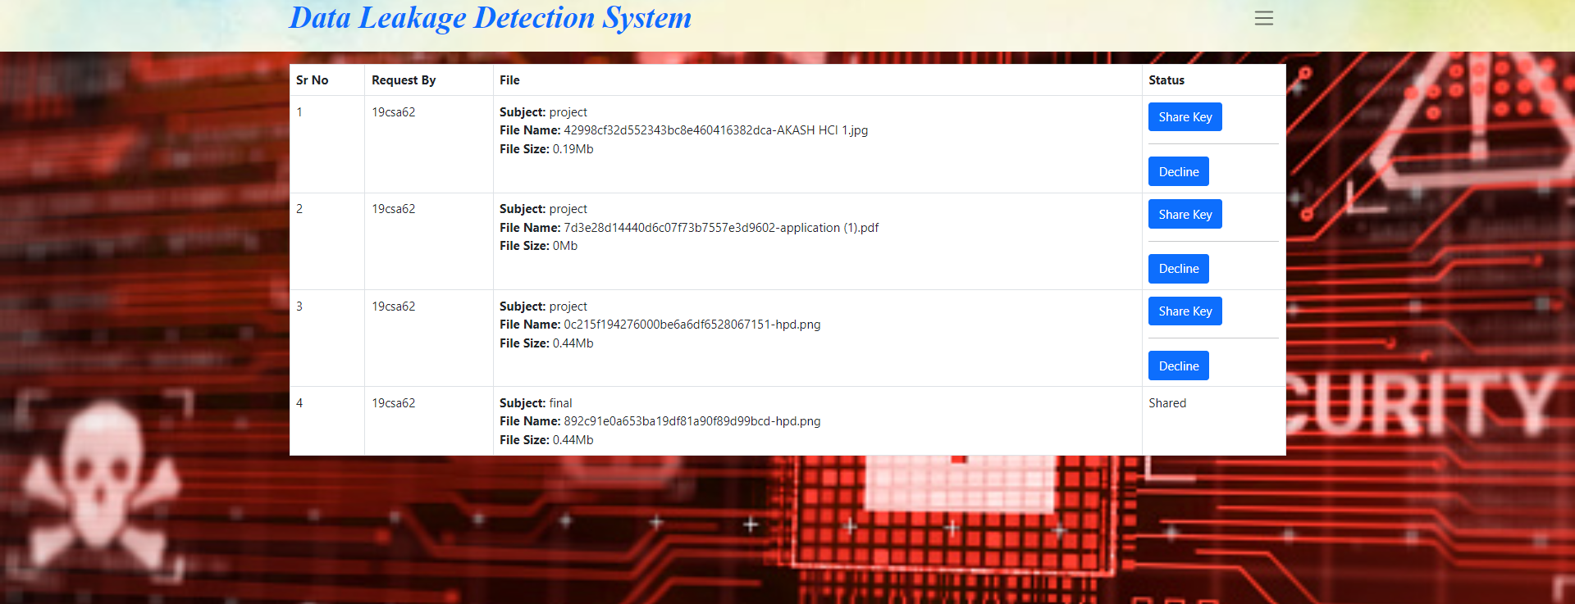
Secret key distribution

Slide 16
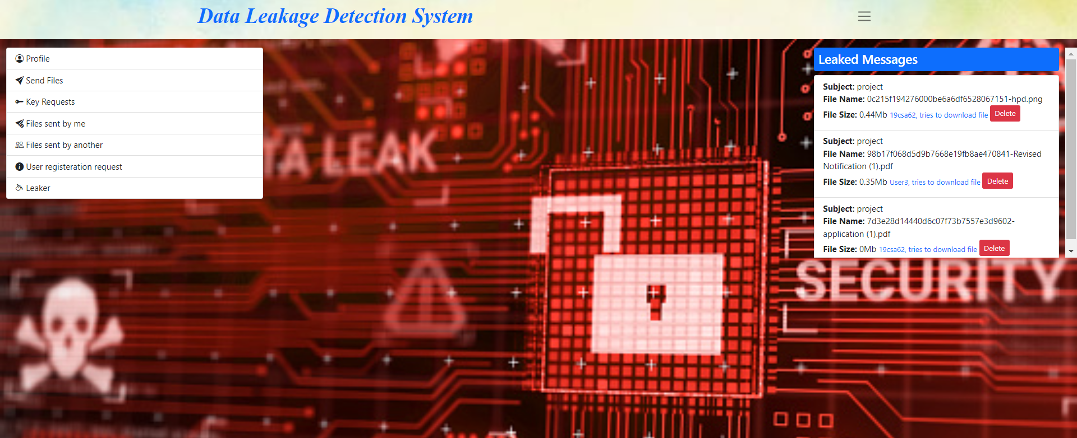
Leaked message detection

Slide 17
conclusion
In conclusion, data leakage and security on cloud computing has the potential to increase the trust and safety of people on cloud through the cloud infrastructure and security protocols as it contains access control, network security, and monitoring. This also shows that this method effectively detects the data leakage on the cloud platforms, When comparing to related operations, the other methods focus more on data leaks occurring at the application level. As this model provides secret key generation, people can feel that their data is more secure from data leakage and breaches.

Slide 18
Future enhancement
The future scope for a data leakage and security is increasing rapidly as The world of computer fields is not static; it is always subject to be dynamic. The technology which is famous today becomes outdated the very next day. Here are some potential areas for future enhancement:
Improving the detection process based on user requirements.
Secure Enclaves: Secure enclaves are isolated execution environments that can protect sensitive code and data from other processes running on the same system. This can be beneficial in cloud environments where multiple users or applications share the same infrastructure.

Slide 19
REFERENCEs
[1] Rishabh Singh, V Gokul Rajan, Galgotias University, U.P. India,May 2022, ‘Data Leakage and Security on Cloud Computing’, vol. 127, no. 1-2.
[2] Chandu Vaidya etl. & BE scholars “Data leakage Detection and Dependable Storage Service in cloud Computing” IJSTE volume 2 issues 10 April 2021 ISSN online 2349-784
[3] Khobragade, P. K., & Malik, L. G., “Data Generation and Analysis for Digital Forensic Application Using Data Mining”. In Communication Systems and Network Technologies (CSNT), 2019 Fourth International Conference on (pp. 458-462). IEEE. April, 2019.
[4] Panagiotis Papadimitriou, Hector GarciaMolina,” Data Leakage Detection”, IEEE transactions on knowledge and data engineering, vol. 23, no. 1, January 2019
[5] Prashant Khobragade, Latesh G. Malik,“A Review on Data Generation for Digital Forensic Investigation using Datamining”, IJCAT International Journal of Computing and Technology, Volume 1, Issue 3, April 2018.

Slide 20
REFERENCEs
[6] Muhammad Azizi Mohd Ariffin, “Data Leakage Detection in Cloud Computing Platform”, August 2019, International Journal of Advanced Trends in Computer Science and Engineering 8(1.3):400-408, DOI:10.30534/ijatcse/2019/7081.3201.
[7] Prof. Sushilkumar N. Holambe, Dr.Ulhas B.Shinde, Archana U. Bhosale, “Data Leakage Detection Using Cloud Computing”, International Journal of Scientific & Engineering Research, Volume 6, Issue 4, April 2020, ISSN 2229-5518.
[8] R. Naik and M. N. Gaonkar, "Data Leakage Detection in cloud using Watermarking Technique," 2019 International Conference on Computer Communication and Informatics (ICCCI), 2019, pp. 1-6, doi: 10.1109/ICCCI.2019.8821894.
[9] Singh, P., & Ranga, V. (2021). Attack and intrusion detection in cloud computing using an ensemble learning approach. International Journal of Information Technology, 13(2), 565-571.

Slide 21
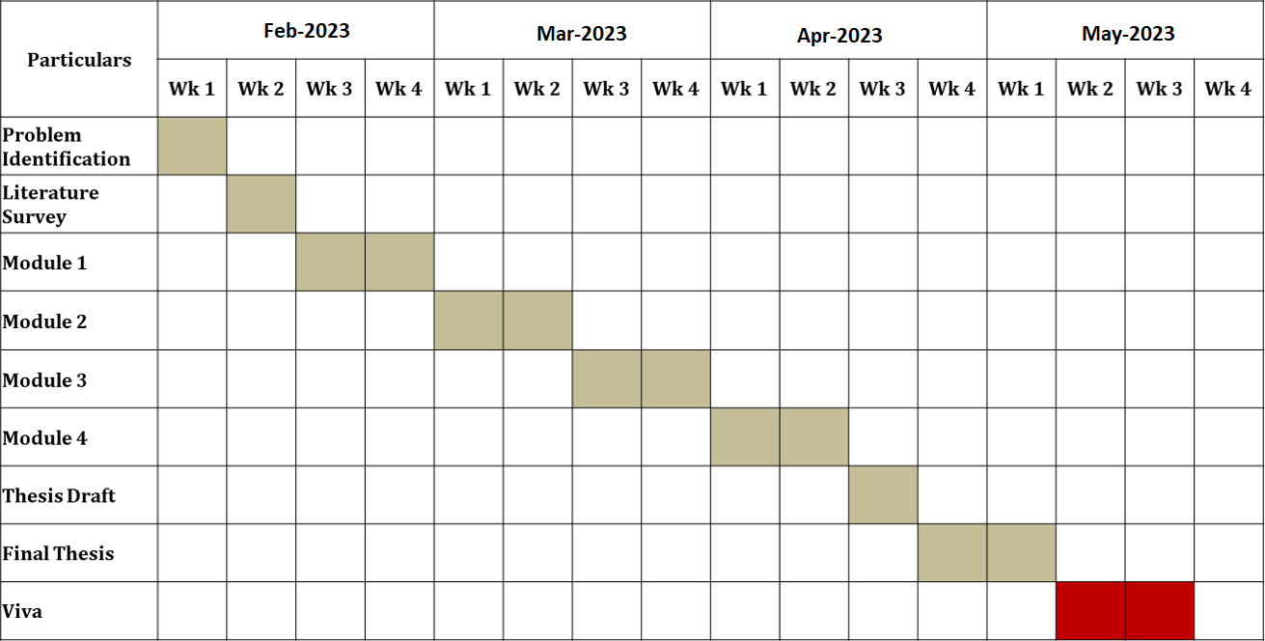
TIMELINE

Slide 22
THANK YOU

